Slide 1
Project Presentation of Co-Op Project at Industry (Module-1)
On
Real-Time Chat Application
CHATPLANE
Supervised By
Dr. Anshu Singla
Department of Computer Science, Chitkara University
Department of Computer Science and Engineering,
Chitkara University, Punjab
Anshul Jain (2210990142) | Swayam Sharma (22109902434) | Shravan (22109904841) | Aaryan (2210990013)

Slide 2
Table of Contents
This presentation provides an overview of the system, its motivation, and implementation approach.
Sections Covered:
Introduction
Problem Statement
Objectives
System Overview
Key Features
Technology Stack
Results & Conclusion
‹#›

Slide 3
Introduction
Communication platforms are essential in today’s digital ecosystem, enabling seamless interaction across academic, professional, and personal domains.
However, users now expect more than just messaging — they demand:
Instant communication
Strong privacy
Smooth user experience
This project focuses on building a real-time chat application that meets these expectations using modern technologies.
‹#›

Slide 4
Problem Statement
Existing messaging platforms have several limitations that affect user experience and security.
Key Issues Identified:
Image compression leads to loss of quality
Limited control over data encryption
Complex backend infrastructure
Inconsistent real-time synchronization
These challenges highlight the need for a system that ensures quality, control, and performance together.
‹#›

Slide 5
Objectives of the Project
This presentation provides an overview of the system, its motivation, and implementation approach.
Sections Covered:
Introduction
Problem Statement
Objectives
System Overview
Key Features
Technology Stack
Results & Conclusion
‹#›

Slide 6
Proposed System Overview
The system is a web-based chat application built with React and Firebase, enabling seamless and synchronized communication.
Core Modules Include:
User Authentication (Login/Signup)
Real-Time Messaging System
Group Chat Environment
Cloud Database Integration
The architecture ensures:
Cloud-based scalability
Instant data synchronization
Multi-device consistency
‹#›

Slide 7
Key Features
This application introduces features that differentiate it from traditional chat platforms.
Unique Capabilities:
Custom Encryption Keys → Users can define their own encryption for group chats
Lossless Image Sharing → Maintains original resolution and quality
Real-time message updates
Secure login using Firebase Authentication
These features provide better privacy, control, and user experience.
‹#›

Slide 8
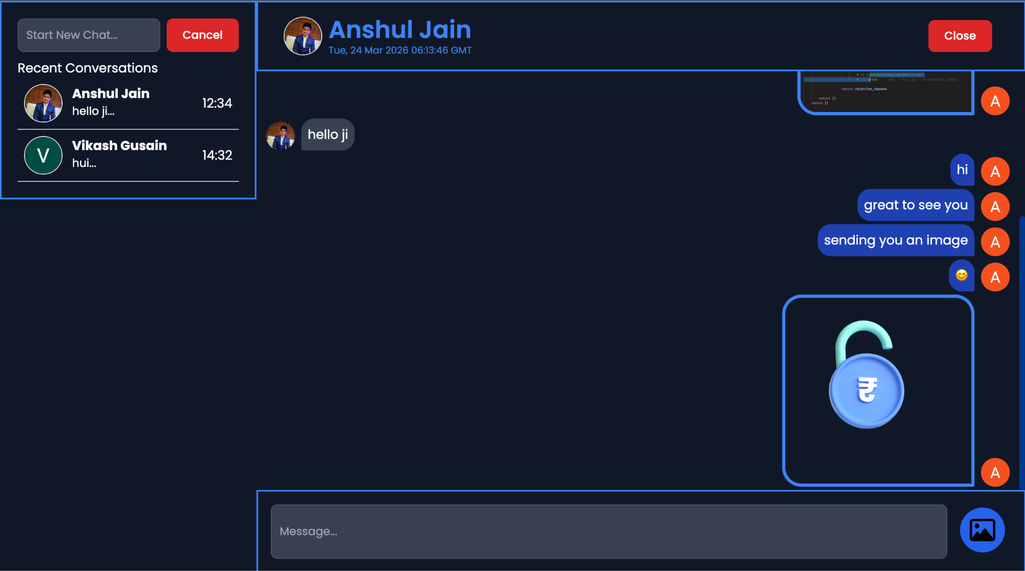

Slide 9
Technology Stack
The application uses a modern and efficient technology stack to ensure performance and scalability.
Frontend:
React.js (Component-based UI, responsive design)
Backend & Services:
Firebase Authentication (User security)
Firestore / Realtime Database (Live data sync)
Cloud Storage (Media handling)
This combination reduces infrastructure complexity while ensuring speed and reliability.
‹#›

Slide 10
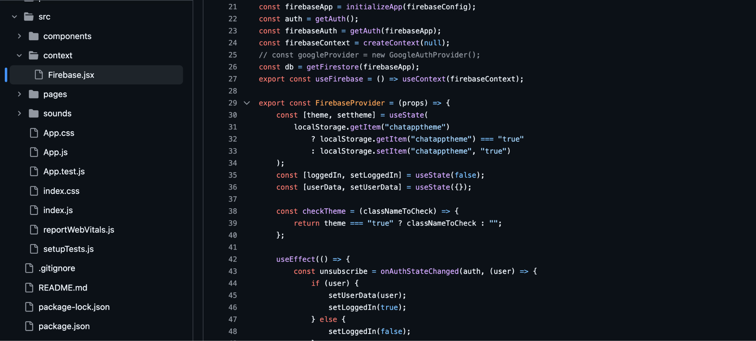

Slide 11
Expected Outcome & Benefits
The system is designed to deliver a powerful and efficient communication experience.
Key Benefits:
Fast and real-time messaging
Enhanced privacy with custom encryption
High-quality media sharing
Scalable cloud-based system
It demonstrates how modern technologies can solve real-world communication challenges effectively.
‹#›

Slide 12
Expected Outcome & Benefits
The project successfully develops a secure and scalable real-time chat application that overcomes limitations of existing platforms.
Key Takeaways:
Combines performance, security, and usability
Introduces user-controlled encryption & lossless media sharing
Built using modern technologies for scalability
The system can be further enhanced with features like video calls, file sharing, or AI-based chat assistance.
‹#›

Slide 13
Thank You
‹#›

